Slide 1
The National Rural Employment Guarantee Act Analysis
By Aryan Bhoraskar

Slide 2
Overview
The Mahatma Gandhi National Rural Employment Act ( or MGNREGA)
of 2005, is a Government Bill passed in 2005 that aims the guarantee to the ‘right of work’.
An Act to provide for the enhancement of livelihood security of the households in rural areas of the country by providing at least one hundred days of guaranteed wage employment in every financial year to every household whose adult members volunteer to do unskilled manual work and for matters connected therewith or incidental thereto.

Slide 3
Problem Statement
NREGA is a vital initiative to alleviate rural unemployment and poverty. This project seeks to address several key questions and challenges associated with NREGA.
How Effective is NREGA in providing employment opportunities to rural households?
Are there regional disparities in the implementation and outcomes of the scheme?
What is the utilization of the allocated budget, and how does it correlate with employment generation?
What are the key factors contributing to the completion of NREGA works, and are there any roadblocks to its success?
Can data-driven insights guide policymakers and administrators in optimizing the scheme's impact?

Slide 4
Dataset Information
The dataset used for this analysis is sourced from official government records and contains information related to NREGA implementation across various states and districts in India. It comprises 28 columns,encompassing data on job cards, worker details, budget allocation, work completion statistics,expenditure, and more.
This dataset offers a comprehensive view of the progress and challenges faced by the NREGA program.

Slide 5
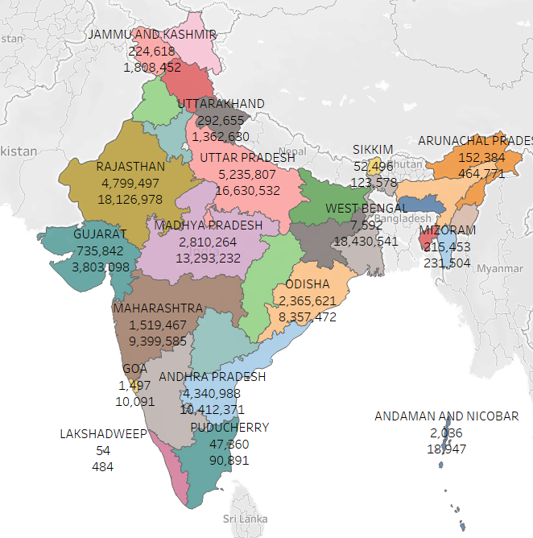
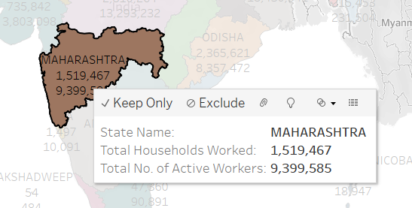
How Effective is NREGA in providing employment opportunities to rural households?

Slide 6
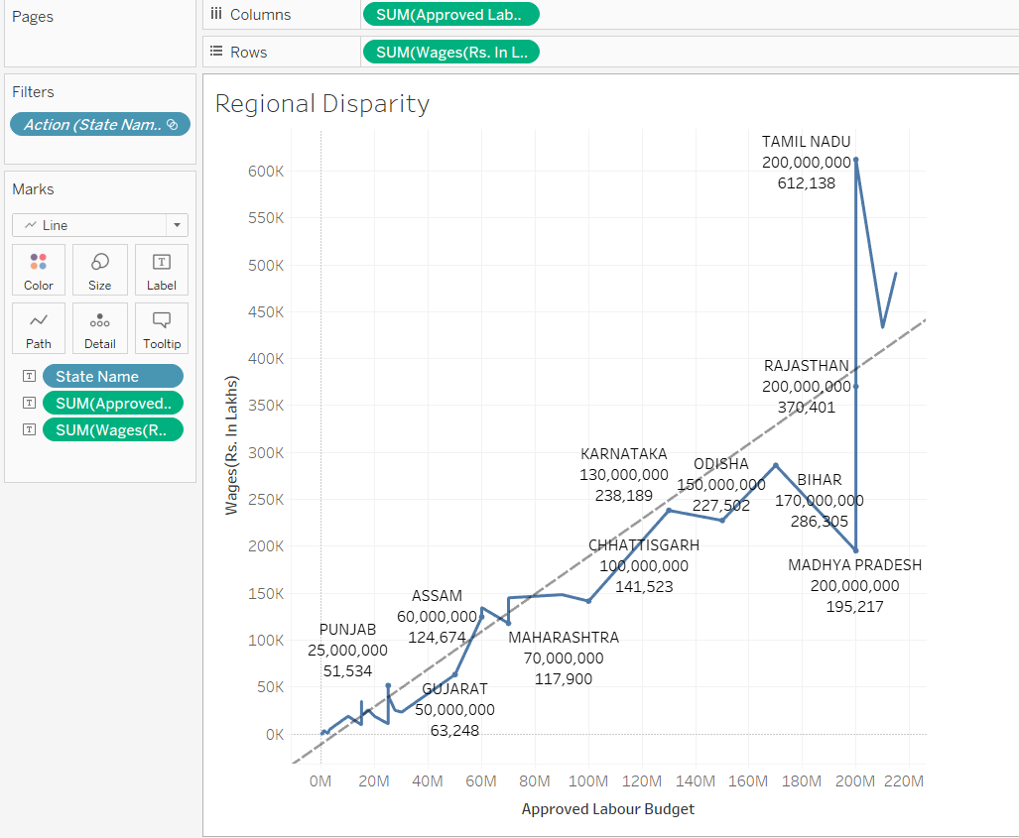
Are there regional disparities in the implementation and outcomes of the scheme?
All the states above the dotted line showcase a strong wage to budget ratio while all those states below the line showcase a poor wage to budget ratio.

Slide 7
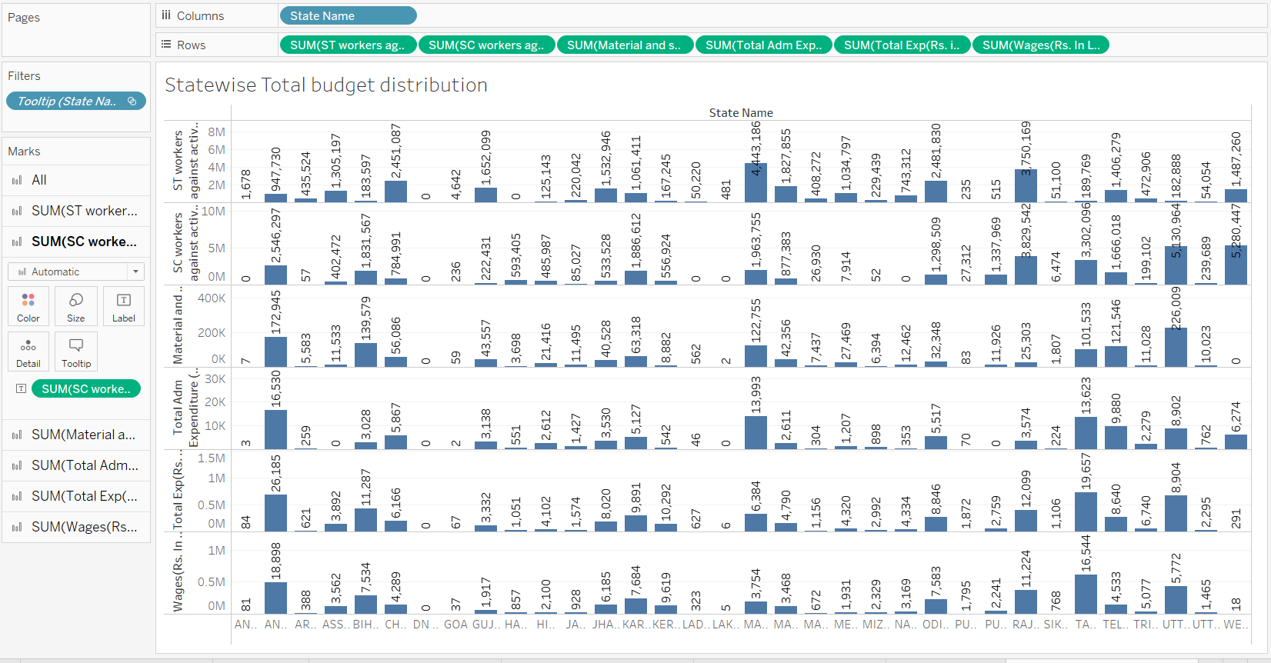
What is the utilization of the allocated budget, and how does it correlate with employment generation?
This sheet shows a statewise distribution the allocated budget into various categories like labour wages, Total admin expenditure, Total Expense etc.

Slide 8
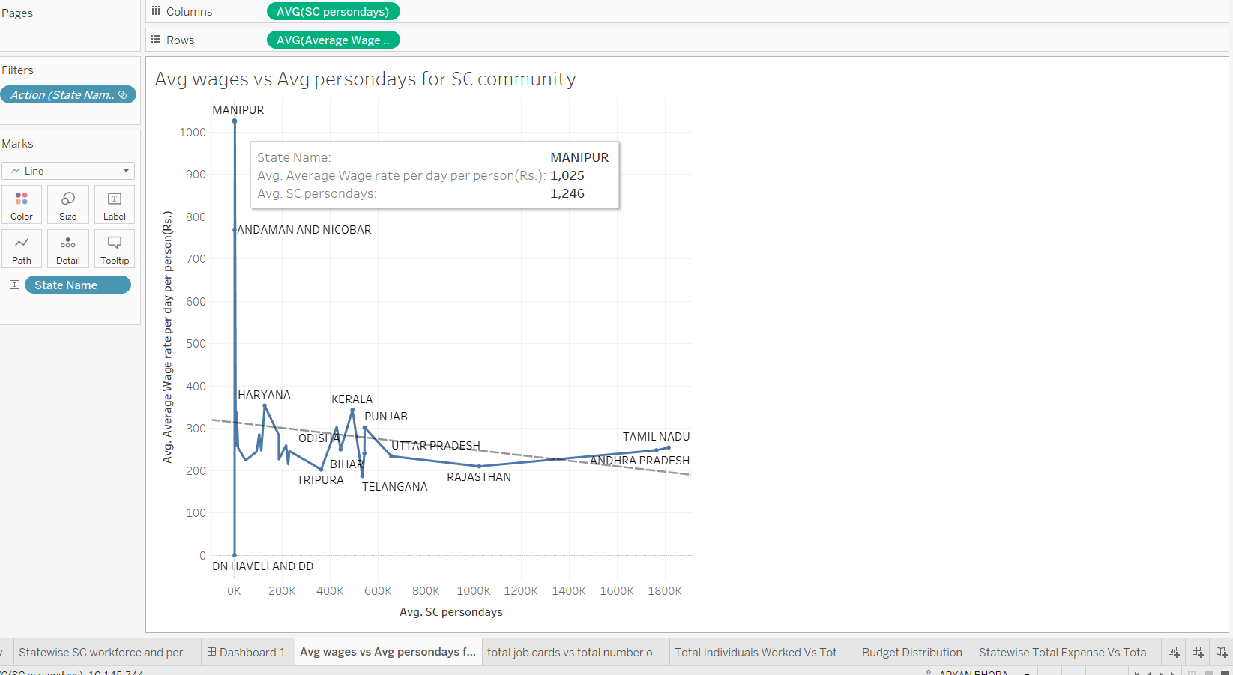
Avg Wage vs Avg personday for SC community
The highest Avg wage to personday ratio was seen in Manipur, which is still a shocking 1025 to 1246.
Sadly, it gets bad to worse when we look at some other states and stats like :
TN : AW = 254, APD = 1.8Mil.
Rajasthan : AW = 210, APD = 1Mil.
Punjab : AW = 302, APD = 543K.
Kerela : AW = 343, APD = 492K.

Slide 9
What are the key factors contributing to the completion of NREGA works, and are there any roadblocks to its success?
Some key success factors:
The people’s motivation to work and sustain themselves.
The cooperation and honest work of the government officials involved in the starting years.
The lack of a tight monopoly over the budget by corrupt politicians.
Some Roadblocks that were later on encountered:
The rise of corruption amongst the government officials. - Most important.
Workers were almost never compensated for their work on time, and the compensation was never fair!!.

Slide 10
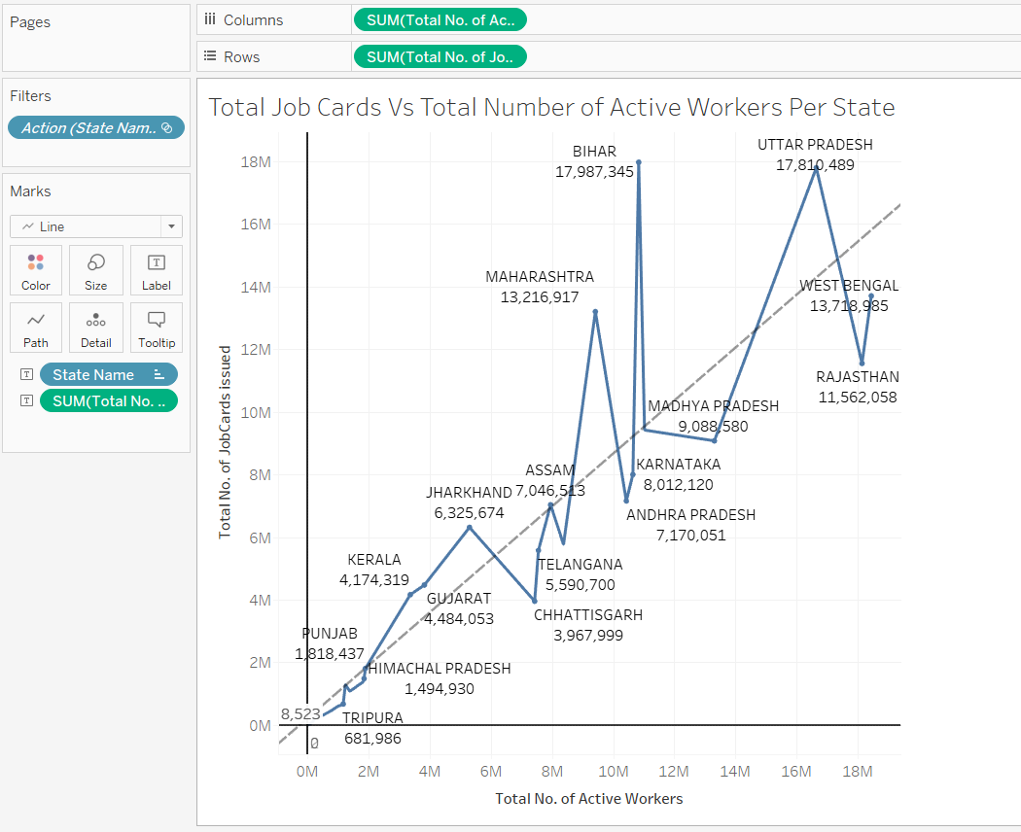
Total Job Cards Vs Total Number of Active Workers Per State
Any state above the straightline showcases a good job card to active worker ratio - workers have rights and are documented under this scheme.
Any state below this straightline showcases a poor job card to active worker ratio - many workers are not documented under this scheme and hence are over-exploited!!

Slide 11
Can data-driven insights guide policymakers and administrators in optimizing the scheme's impact?
The clear answer is YES!!
It has been observed that data regarding these government schemes are often mishandled, tampered or even lost due to poor handling.
This can lead to severe loss of time and energy, along with the negative side-effect of unaccountability amongst government officials, surge in feelings of mistrust amongst the people toward the government and loss of public image in the international front.

Slide 12
THANK YOU!!

